Slide 1

AASD 4004
Machine Learning - II
Applied AI Solutions Developer Program

Slide 2
Module 03 Text Classification
Vejey Gandyer

Slide 3
Agenda
Text Classification
Classification Pipeline
Acquire / Load dataset
Pre-process dataset
Split dataset
Feature Extraction
Train the classifier
Evaluate the classifier
Benchmark algorithms with feature extractors

Slide 4
Text Classification
What is it?

Slide 5
Text Classification
Assigning one or more categories to a given piece of text from a larger set of possible categories
Examples
Spam Vs Non-spam emails (Two-class / Binary)
High-risk vs Medium-risk vs Low-risk loan provision (Multi-class)
Article tags classification(Multi-label)

Slide 6
Classification Pipeline

Slide 7
Classification Pipeline
Acquire / Load the dataset
Pre-process the text
Split the dataset
Extract features from text
Train the classifier
Evaluate the classifier

Slide 8
Classification Pipeline
Load dataset

Slide 9
Load dataset
Load the dataset

Slide 10
Classification Pipeline
Pre-process dataset

Slide 11
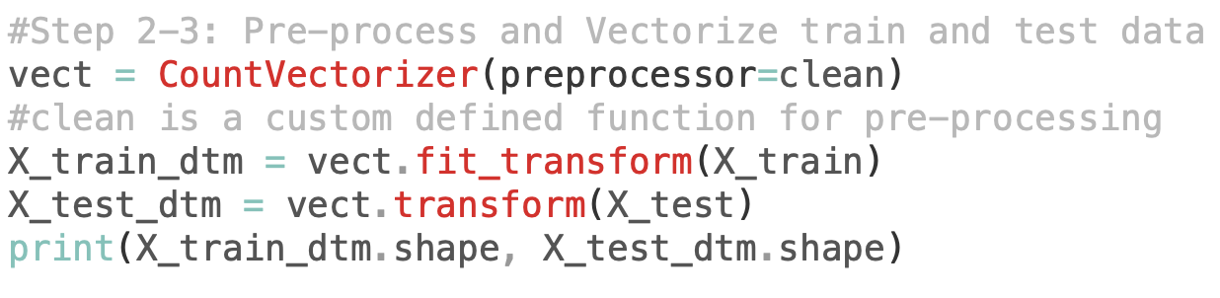
Pre-process dataset
Pre-process the text

Slide 12
Classification Pipeline
Split dataset

Slide 13
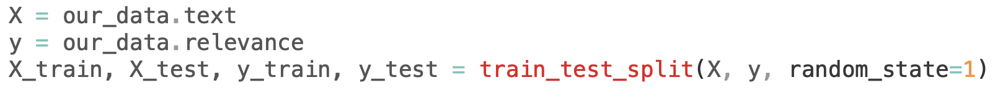
Split the dataset
Split the dataset

Slide 14
Classification Pipeline
Extract features

Slide 15
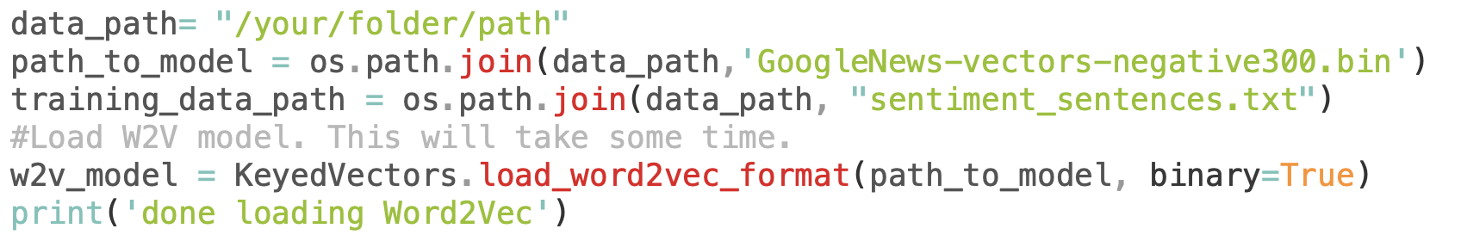
Extract Features
Word Embeddings - Word2Vec (Gensim)

Slide 16
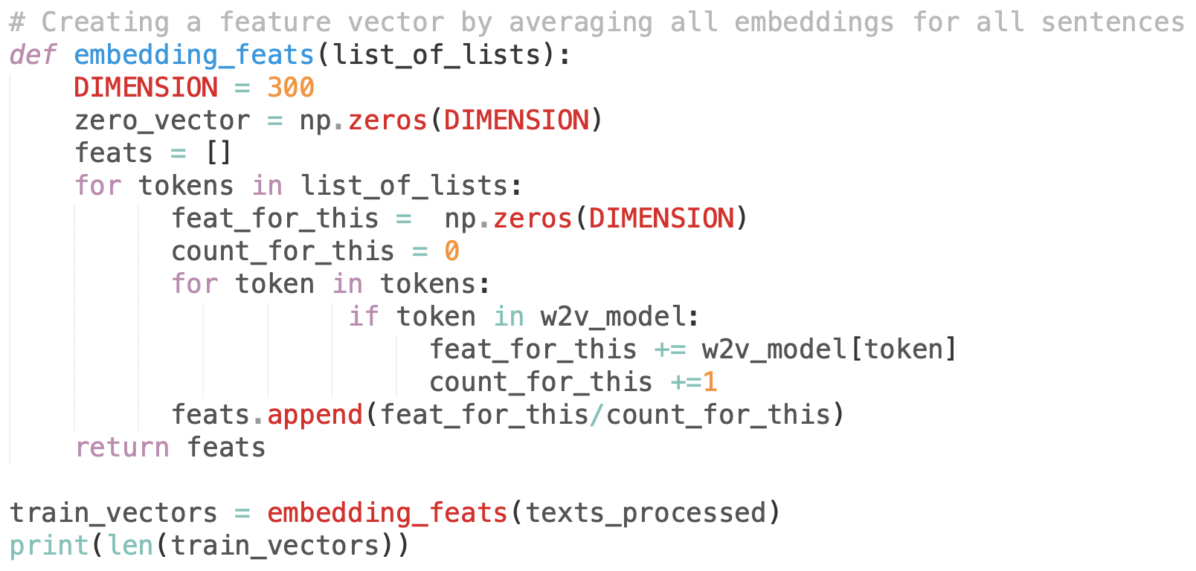
Extract Features
Creating own Embeddings

Slide 17
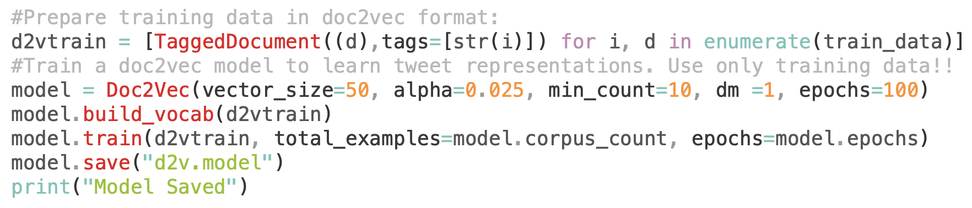
Extract Features
Doc2Vec Embeddings

Slide 18
Classification Pipeline
Train classifier

Slide 19
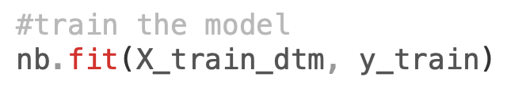
Train the classifier
Instanstiate the classifier
Train the classifier

Slide 20
Classification Pipeline
Evaluate classifier

Slide 21
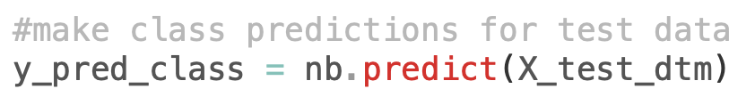
Evaluate the classifier
Evaluate the classifier

Slide 22
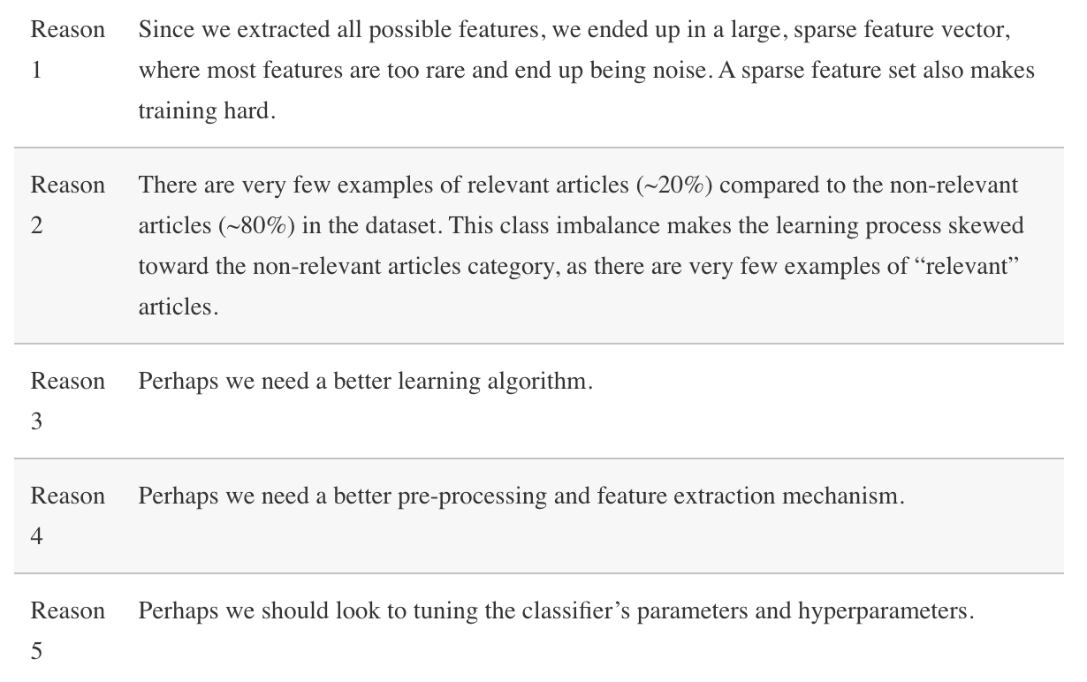
Evaluate the classifier
Reasons for Poor Classifier

Slide 23
Benchmarking algorithms
Multinomial Naïve Bayes, Logistic Regression, Support Vector Machines, Decision Trees

Slide 24
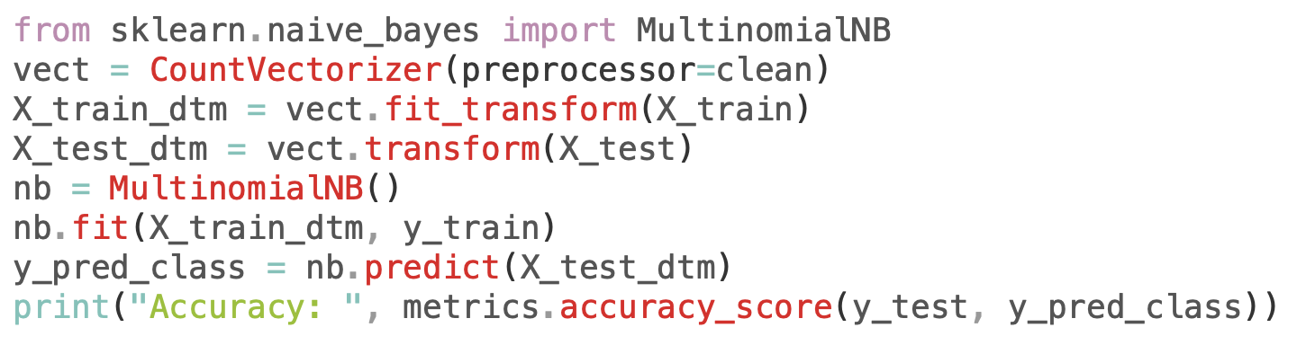
Multinomial Naïve Bayes
Multinomial Naïve Bayes

Slide 25
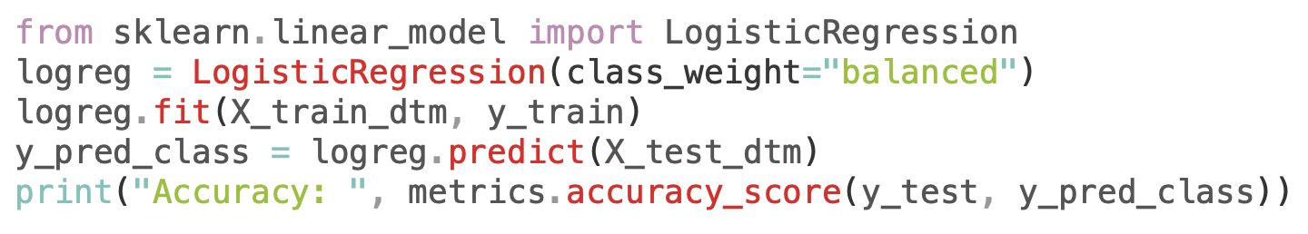
Logistic Regression
Logistic Regression

Slide 26
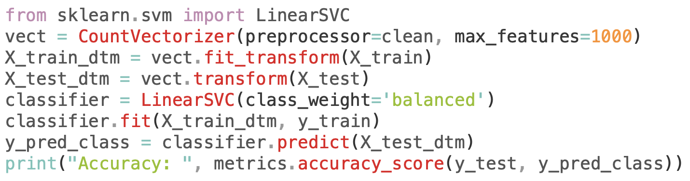
Support Vector Machine
Support Vector Machine

Slide 27
Assignment: Benchmarking algorithms with algorithms, feature extractors
Algorithms: Multinomial Naïve Bayes, Logistic Regression, Support Vector Machines, Decision Trees
Feature Extractors: CountVectorizer, Word2Vec, Doc2Vec, Fastai

Slide 28
Benchmarking Algorithms and Feature Extractors
Create a benchmark analysis with different algorithms and feature extractors.
Algorithms: Multinomial Naïve Bayes, Logistic Regression, Support Vector Machines, Decision Trees
Feature Extractors: CountVectorizer, Word2Vec, Doc2Vec, Fastai
Benchmark all the possible above configurations and choose the best algorithm and feature extractor amongst all configurations

Slide 29
Further Reading
Scikit-learn documentation
https://scikit-learn.org/

